Slide 1



Sportify
Sign In
Register
Exit
A Project by
Hiranmaya Gundu
Saurabh Chheda
Notes:
Splash Screen

Slide 2

Sportify
Log In
Username
Password
Sign In
Notes:
Splash Screen

Slide 3
Sportify
Register
Username
Password
Confirm Password
Confirm
Notes:
Splash Screen

Slide 4
Sportify
Sorry!
Username already taken
Notes:
Splash Screen

Slide 5
Sportify
Sorry!
Passwords don’t match
Notes:
Splash Screen

Slide 6
Sportify
You’re registered!
Notes:
Splash Screen

Slide 7
Sportify
Sorry!
Username doesn’t exist
Sign Up
Notes:
Splash Screen

Slide 8

Sportify
Football
Basketball
Sign Out
Notes:
Splash Screen

Slide 9

Football
Rank | Home | Away | League | Venue | Date and Time
1
2
3
4
5
6
7
8
9
10

Slide 10
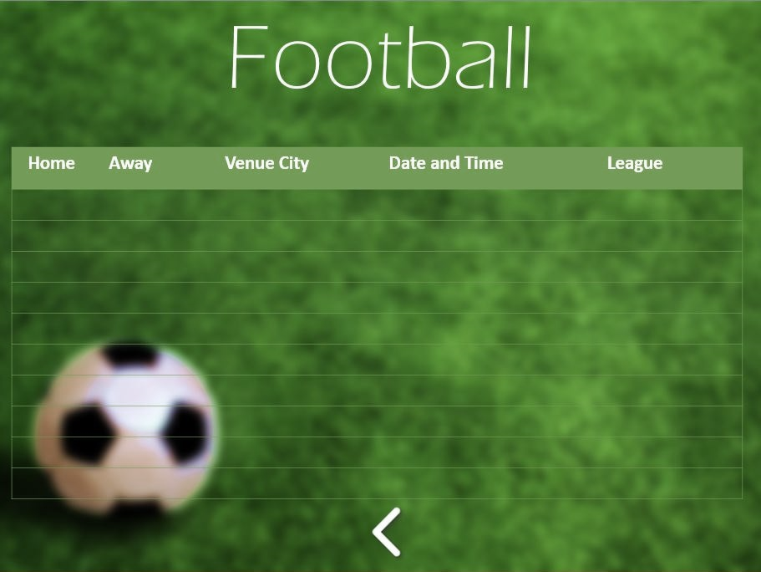
Downloading
Please Wait…

Slide 11


NBA
Rank | Home | Away | Venue | Date and Time
1
2
3
4
5
6
7
8
9
10

Slide 12
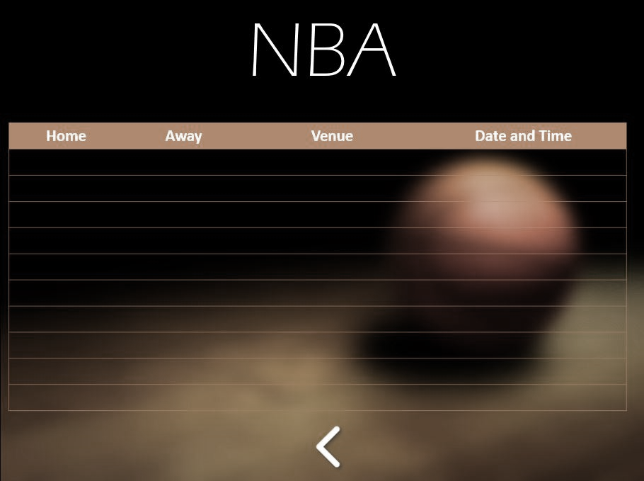
Downloading
Please Wait…

